Slide 1
Design patterns
Soon Phei, Tin

Slide 2
Topic Objective
Coursework 1
Introduction to design patterns
Creation patterns
Structural patterns

Slide 3
Group Coursework - Key Information
All group members are responsible for all assigned tasks. All contributing members of the group receive the same mark.
All group members are equally and collectively responsible for the entire submission.
All group members are held jointly accountable for the academic integrity of the entire submission. Violations of academic integrity including failure to monitor group member contribution originality constitutes negligence.
Unreported suspicious academic misconduct by one group member will be attributed to ALL members in terms of penalties.
A signed submission cover page is required (physical signature by all members), scanned and then attached as the first page of the submission. Missing signatures or those signed on one’s behalf or the completion of fake information will result in mark penalties.

Slide 4
What is Design Pattern?
Design patterns are typical solutions to commonly occurring problems in software design.
They are like pre-made blueprints that you can customize to solve a recurring design problem in your code.
The pattern is not a specific piece of code that you can copy and paste, but a general concept for solving a particular problem.
You can follow the pattern details and implement a solution that suits the realities of your own program.

Slide 5
What Can I Find In A Pattern?
Most patterns are described very formally so people can reproduce them in many contexts.
Here are the sections that are usually present in a pattern description:
Intent of the pattern briefly describes both the problem and the solution.
Motivation further explains the problem and the solution the pattern makes possible.
Structure of classes shows each part of the pattern and how they are related.
Code example in one of the popular programming languages makes it easier to grasp the idea behind the pattern.
The consequences are the results and trade-offs of applying the pattern.
etc

Slide 6
How Do You Use Design Pattern?
Use it primarily as a communication tool instead of a design tool.
Sometime it can become a cautionary tale – things to do or not to do.
We don’t jump on to a design pattern, rather we arrive at a design pattern.
When YOUR design come close to a design pattern, you should consider to lean toward that design pattern, rather than seeking for a design pattern in the very beginning.
Do not force yourself to use a pattern.

Slide 7
Benefits of Design Patterns
Reusability: Design patterns provide solutions that can be reused in multiple projects, reducing the overall development time.
Best Practices: They reflect the experience and insights of software development professionals, thereby representing best practices in the field.
Understandability and Maintainability: They apply a consistent, well-understood, and well-documented approach to software design which makes the code easier to understand and maintain.
Communication: The use of well-known design patterns can improve communication within the development team by providing a common vocabulary.

Slide 8
Drawbacks of Design Patterns
Overuse: Sometimes, a simple solution is more efficient and easier to understand. Using a design pattern where it's not needed can lead to unnecessary complexity.
Initial Overhead: Understanding and implementing design patterns can be time-consuming initially and may slow down the development process.
Specificity: Design patterns are not one-size-fits-all solutions. They provide solutions for specific situations and might not be applicable to all cases.
Dependence: Over-reliance on design patterns could limit the developer's ability to think outside the box and come up with innovative solutions.
Difficulty in Learning: Some design patterns can be complex to learn and implement, especially for less experienced developers.

Slide 9
Classification of Design Patterns
All patterns can be categorized by their intent, or purpose. This chapter covers three main groups of patterns:
Creational patterns provide object creation mechanisms that increase flexibility and reuse of existing code.
Structural patterns explain how to assemble objects and classes into larger structures, while keeping the structures flexible and efficient.
Behavioral patterns take care of effective communication and the assignment of responsibilities between objects.

Slide 10
Creational Patterns
Creational design patterns are used to deal with object creation, aiming to create objects in a manner suitable to the situation.
Flexibility: provide a way to make a system independent of how its objects are created, composed, and represented.
Reusability: Bya defining separate factory classes or methods for object creation, the same code can be reused to get instances of classes rather than creating them again and again, making for less redundant code.
Abstraction: Creational design patterns abstract the instantiation process. They hide the implementation details of the objects that are being created.
Control Over Object Creation: Creational patterns give more control over the object creation process and encapsulate this process in a separate function or class, allowing the developer to change or refine what classes do without affecting other parts of the code.

Slide 11
5 creational patterns
The Factory Pattern provides a simple decision making class that returns one of several possible subclasses of an abstract base class depending on the data that are provided.
The Abstract Factory Pattern provides an interface to create and return one of several families of related objects.
The Builder Pattern as name implies, is an alternative way to construct complex objects. This should be used only when you want to build different immutable objects using same object building process.

Slide 12
5 creational patterns
The Prototype Pattern starts with an initialized and instantiated class and copies or clones it to make new instances rather than creating new instances.
The Singleton Pattern is a class of which there can be no more than one instance. It provides a single global point of access to that instance.

Slide 13
The Factory pattern
Gang Of Four Definition
Define an interface for creating an object, but let subclasses decide which class to instantiate. The Factory method lets a class defer instantiation it uses to subclasses
One of the most used design patterns in the real-world applications
Object
creates
Factory
uses
Client

Slide 14
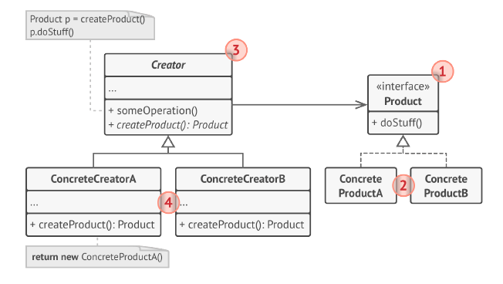
Factory Pattern
This pattern is particularly useful when a class cannot anticipate the class of objects it needs to create, or when a class wants its subclasses to specify the objects it creates.

Slide 15
Factory Example:
Burger
<<Interface>>
Restaurant
<<Abstract Factory>>
orderBurger
BeefBurger
<<Implementation>>
VeggieBurger
<<Implementation>>
BeefBurgerRestaurant
<<Concrete Factory>>
VeggieBurgerRestaurant
<<Concrete Factory>>

Slide 16
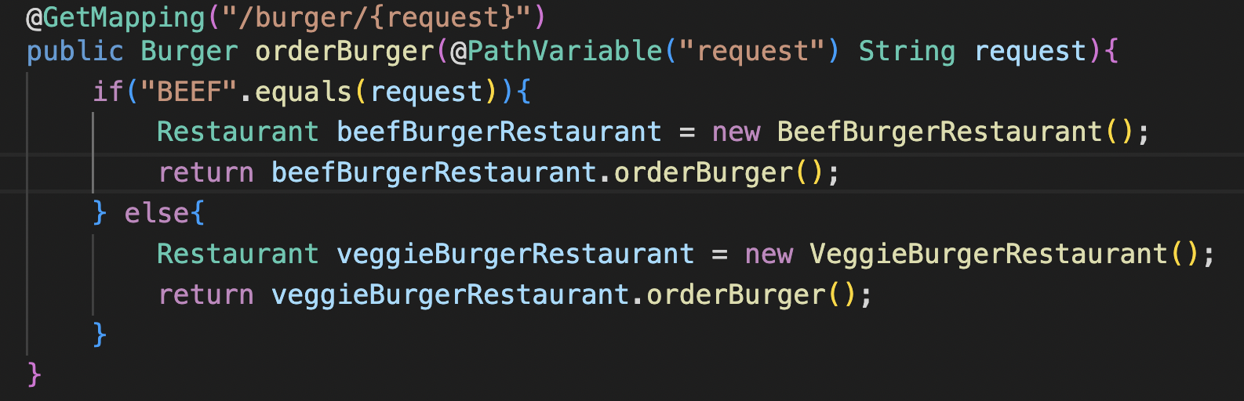
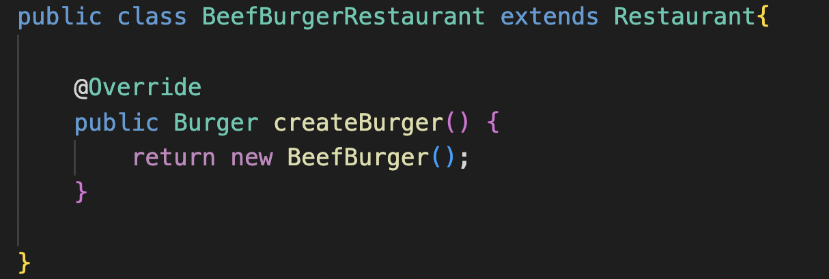
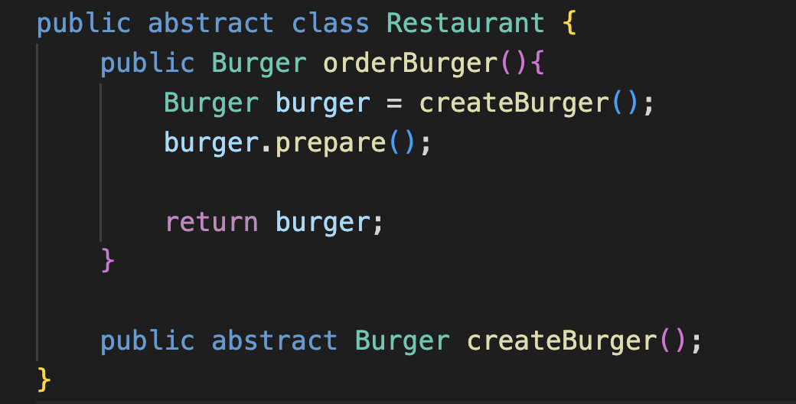

Slide 17
Exercise 1
Extend the Burger Restaurant
Base on the factory example, extend the code following Factory Pattern to accept the ordering of Chicken Burger.
Do it now!

Slide 18
Exercise 2
A document management system in which documents can be in different formats like Word, PDF, Excel, etc. The documents need to be opened, saved, and closed. How do we organize our object-oriented system to handle this diversity, keeping in mind that in the future we may have to introduce more document types?

Slide 19
Builder Pattern
The Builder pattern is a creational pattern –it's used to create and configure complex objects.
Use to simplify the complexity of the object initialization by letting you construct an object step by step.

Slide 20
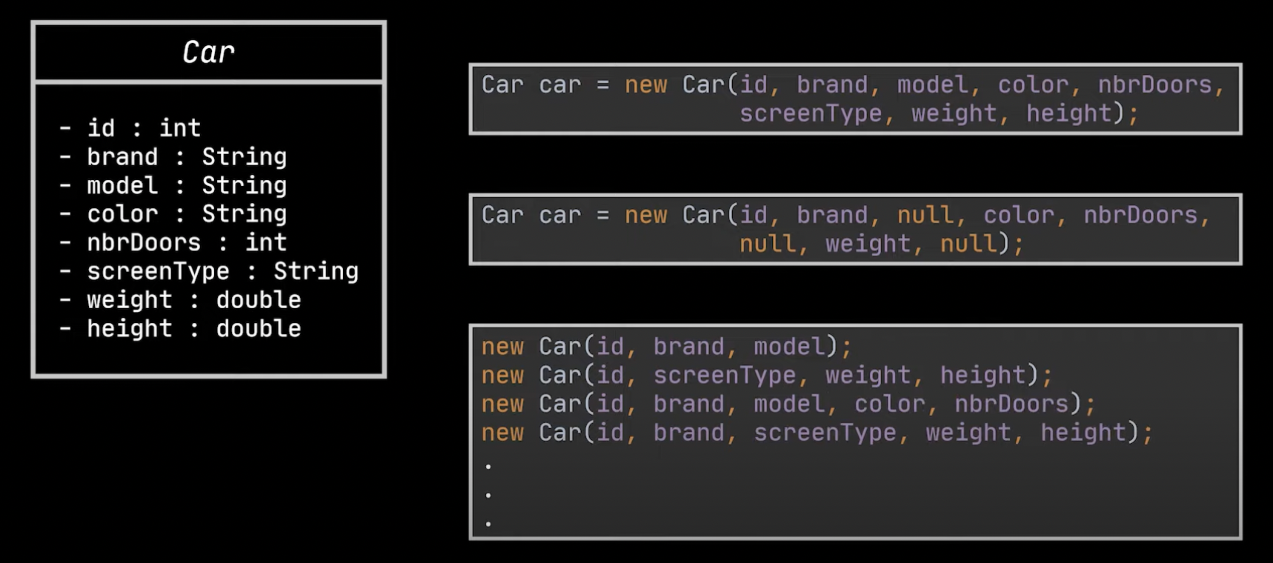
Builder Pattern – The Problem to Solve

Slide 21
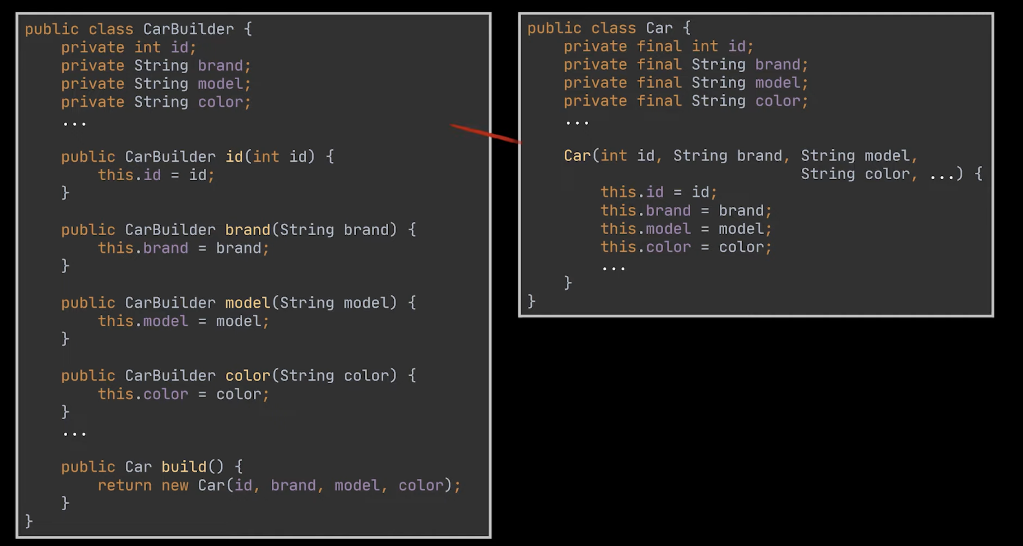
Builder Pattern
The builder pattern extract the object construction code out of its own class and move it to a separate objects called Builder.

Slide 22
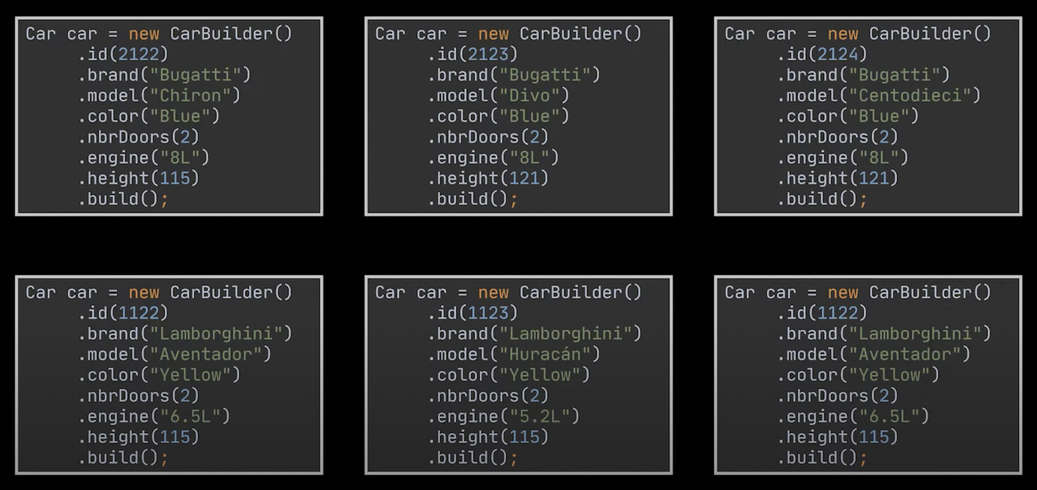
Using the Builder Class

Slide 23
Enhancement To The Builder
Referring to the previous slide, can we make the construction of the object easier?
Introduce a Director class to manage the order in which we should call the construction steps so that we can reuse specific configurations of the products we are building.
Director is an optional class in the pattern.
It helps to hides the details of the product construction from the client code.

Slide 24
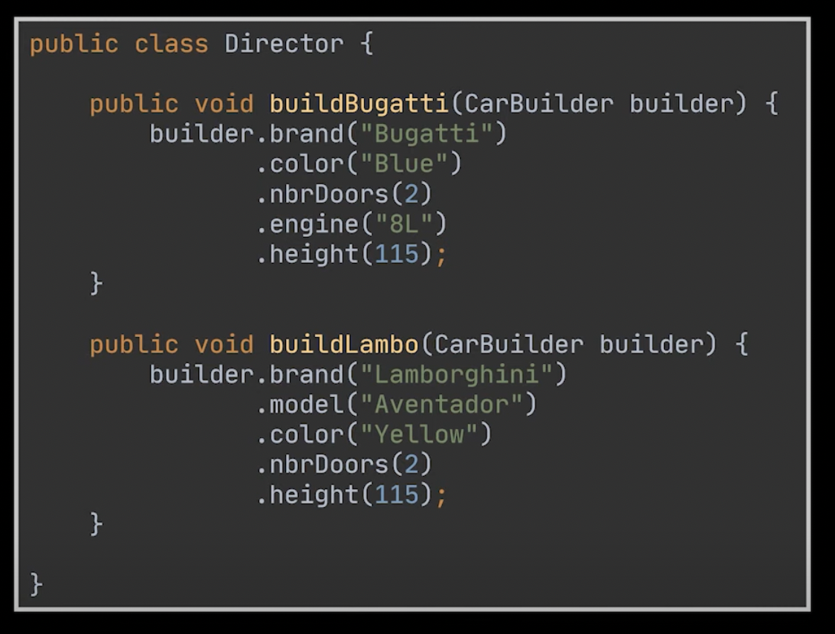
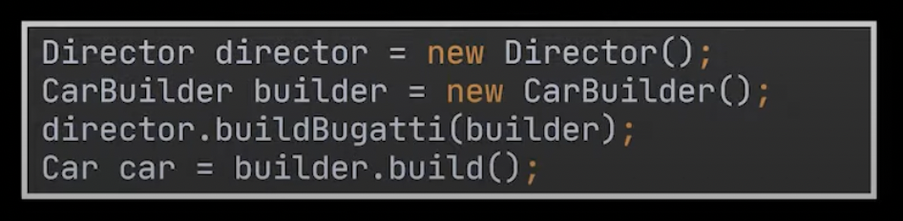
Director

Slide 25
Application of Builder Pattern
Use the Builder pattern to get rid of a constructor with many optional parameters.
Use the Builder pattern when you want your code to be able to create different representations of same product without confusing the client.

Slide 26
Scenario Where We Use Builder Pattern
A Robot might have many parts like head, body, arms, legs, etc., and each of these parts might have many options. For example, the robot's body could be made of metal, plastic, or some advanced alloy. The robot's head might contain different types of sensors and processors.
When you're dealing with an object that has a complex configuration. For instance, consider an online pizza ordering system. Pizzas can have a wide variety of options (e.g., crust type, size, toppings, cheese, sauce) and the ordering process can be effectively managed using a Builder pattern.
Consider a scenario where you are designing a complex 3D game with different types of characters. Each character in the game could have multiple attributes like strength, speed, health, weapon, and abilities. Building these characters directly could be quite complex as each character could have different kinds of abilities, weapons and attributes.

Slide 27
Structural Patterns
Structural design patterns are essential because they provide a manner to simplify and manage the relationships between different software entities. They guide us in composing objects to form larger structures while keeping these structures flexible and efficient.
Code Reusability: They provide solutions to problems that occur frequently in software design, and by using these patterns, we can reuse solutions that have been proven effective.
Improved Modularity: Structural patterns can greatly improve modularity in a program by providing ways to decouple systems and create interfaces.
Code Maintenance: They make the code easier to understand and maintain by ensuring that classes and objects are well-organized and well-structured.
Flexibility: They enable us to change the system's components independently, which leads to higher flexibility.

Slide 28
Structural Patterns
Adapter Pattern acts as a connector between two incompatible interfaces that otherwise cannot be connected directly. An adapter wraps an existing class with a new interface so that it becomes compatible with the client’s interface.
Bridge Pattern is to decouple an abstraction from its implementation so that the two can vary independently.
Composite Pattern is meant to allow treating individual objects and compositions of objects, or “composites” in the same way.
Decorator Pattern can be used to attach additional responsibilities to an object either statically or dynamically.

Slide 29
Structural Patterns
Facade Pattern encapsulates a complex subsystem behind a simple interface. It hides much of the complexity and makes the subsystem easy to use.
Flyweight Pattern allows programs to support vast quantities of objects by keeping their memory consumption low. Pattern achieves it by sharing parts of object state between multiple objects.
Proxy Pattern specifies a design where substitute or placeholder object is put in-place of the actual target object to control access to it. Client accesses the proxy object to work with the target object.

Slide 30
Decorator Pattern
The decorator design pattern allows us to dynamically add functionality and behavior to an object without affecting the behavior of other existing objects in the same class.
We use inheritance to extend the behavior of the class. This takes place at compile time, and all the instances of that class get the extended behavior.
Apply decorator to an individual object based on our requirement and choice.

Slide 31
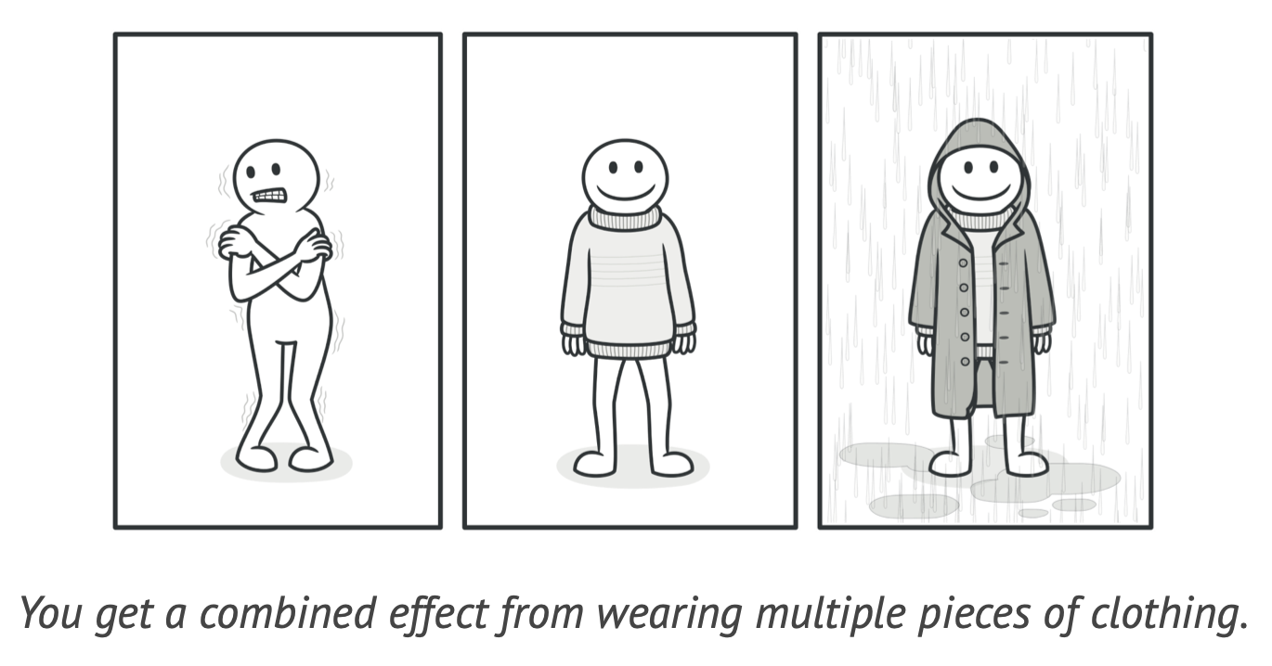
Decorator Pattern
Decorator a.k.a. Wrapper
Uses abstract classes or interfaces with the composition to implement the wrapper.
Decorator pattern create decorator classes, which wrap the original class and provide additional functionality by keeping the class methods' signature unchanged.

Slide 32
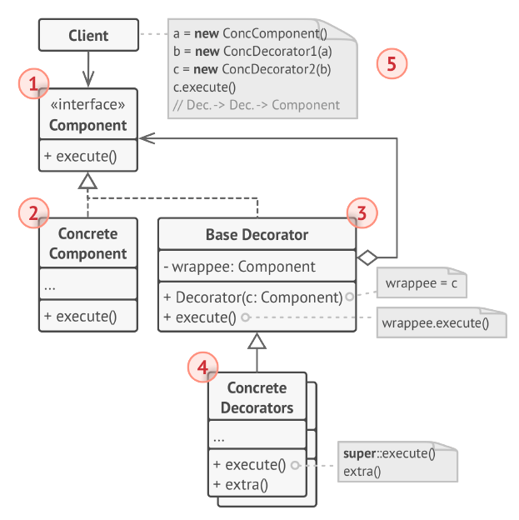
Decorator Pattern – The Structure
Also check out the sample Java code, Robot.

Slide 33
Key Components
The Component declares the common interface for both wrappers and wrapped objects.
Concrete Component is a class of objects being wrapped. It defines the basic behavior, which can be altered by decorators.
The Base Decorator class has a field for referencing a wrapped object. The field’s type should be declared as the component interface so it can contain both concrete components and decorators. The base decorator delegates all operations to the wrapped object.
Concrete Decorator define extra behaviors that can be added to components dynamically. Concrete decorators override methods of the base decorator and execute their behavior either before or after calling the parent method.

Slide 34
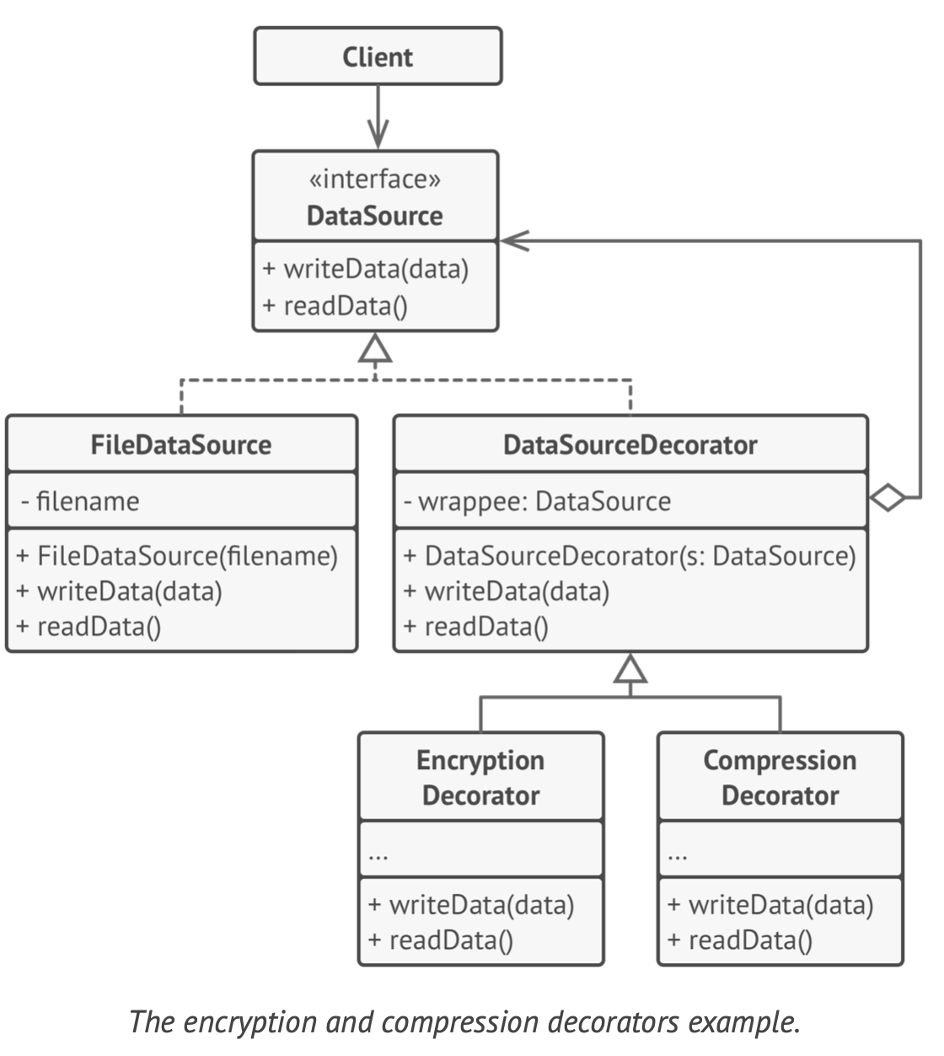
Decorator Pattern – Data Source Example

Slide 35
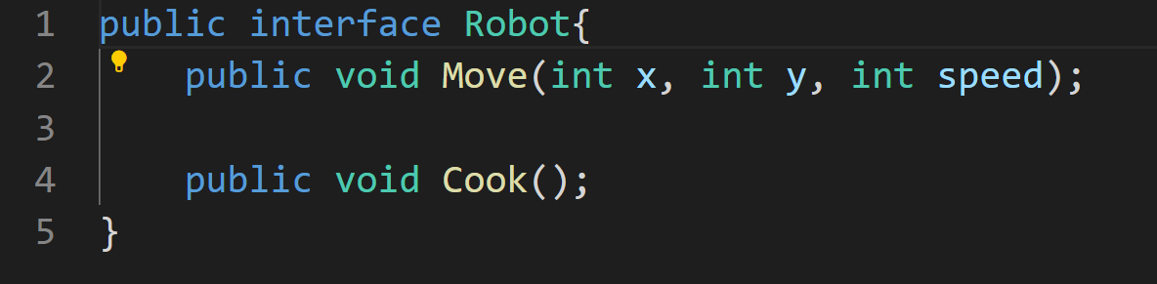
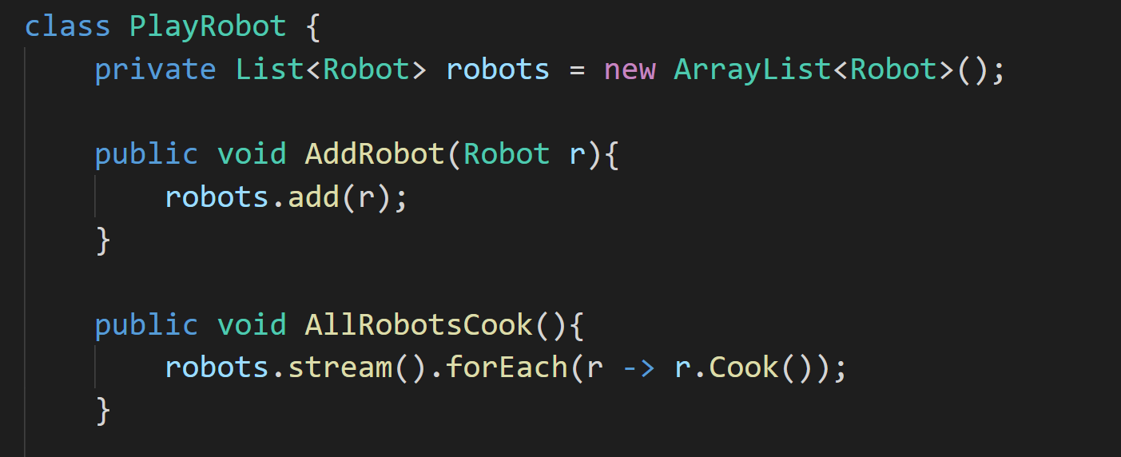
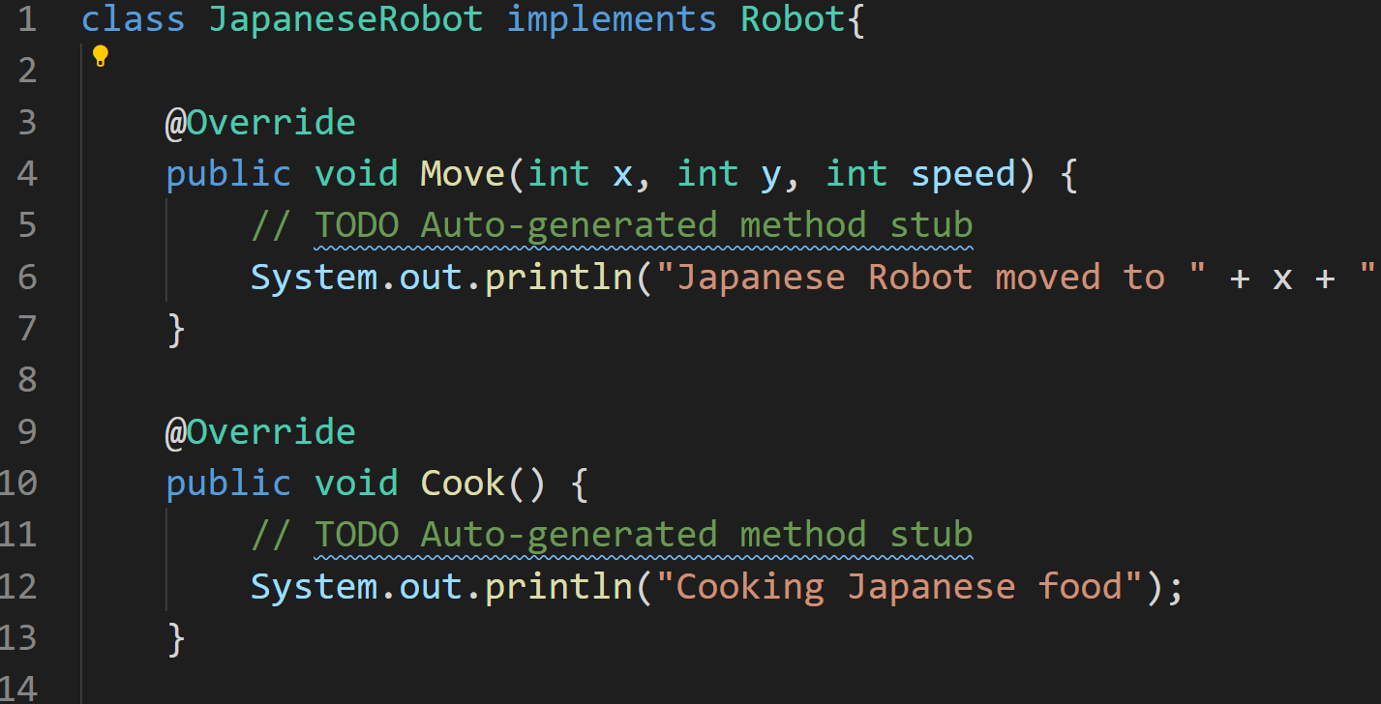
Example
Suppose we have a Robot interface, which included Move() and Cook(). You want some of your robot instances to do more things.

Slide 36
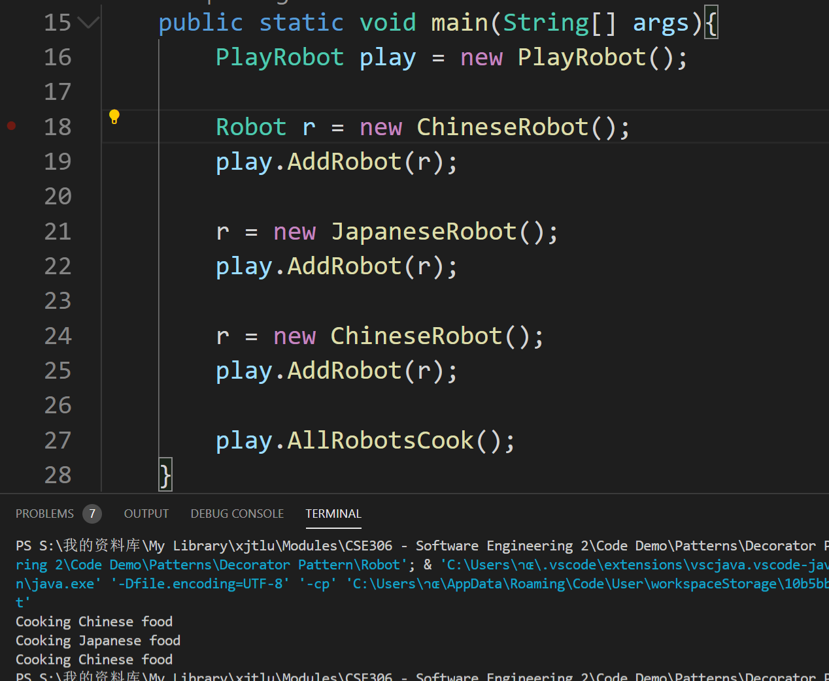
Example
I want my third robot to cook according to customer’s gender. Female get a small portion, male get a big portion.

Slide 37
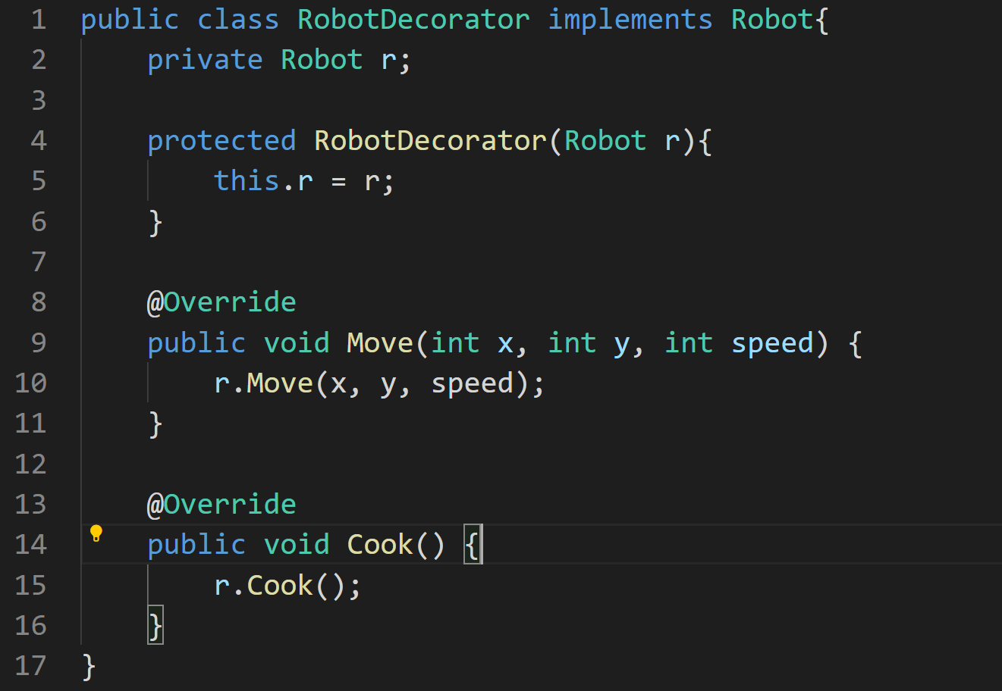
Example
A decorator implements Robot interface and hold an instance of Robot (r), which would like to have additional functionalities.
The decorator must ensure all methods in the interface are implemented by delegating to robot r.

Slide 38
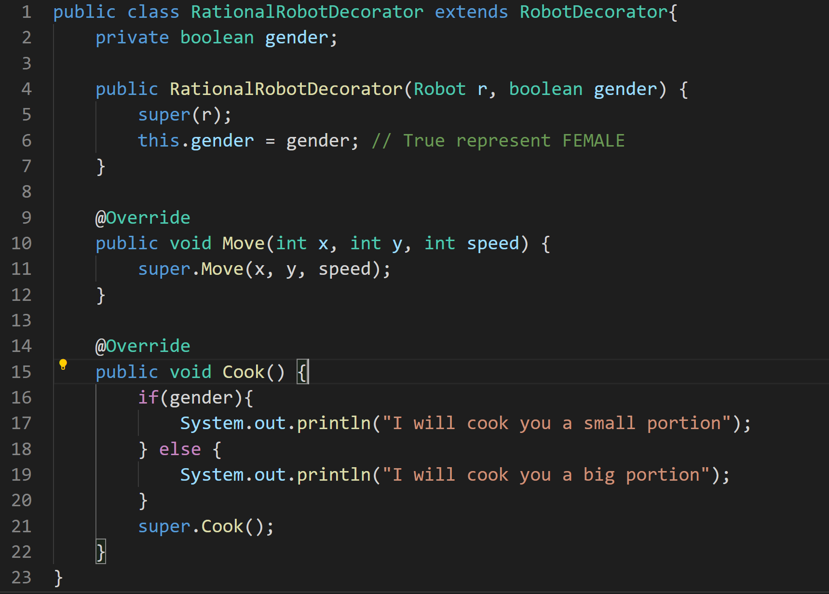
Example
To add functionalities, the class (RationalRobotDecorator) extends RobotDecorator and adding new functions by overriding the decorator’s methods.

Slide 39
Application of Decorator Pattern
Use the Decorator pattern when you need to be able to assign extra behaviors to objects at runtime without breaking the code that uses these objects.
Use the pattern when it’s awkward or not possible to extend (class with final keyword) an object’s behavior using inheritance.

Slide 40
Exercise 3
A new type of Robot is invented. It is smarter because it can apply deep learning to cook better.
Now, any Robot can be a rational robot at the same time smart robot.
Enhance the above example by implement a SmartRobotDecorator.
Illustrate that a Robot can be rational and smart at the same time.

Slide 41
Exercise 4
Let's think about a cafe scenario. When you go to a cafe, you usually start with a basic type of coffee, then you customize it by adding extra features like milk, sugar, flavors, whipped cream, etc. Plus, each of these additions affects the final cost of the coffee.
Implementing this in a straightforward way could quickly become complicated and messy, especially if you want to be able to add, remove, and modify these customizations dynamically.
This is a perfect scenario for the Decorator pattern. In this pattern, a class represents the base object (in this case, a plain coffee), while other decorator classes represent the optional extras. The decorators wrap the base class and other decorators, forming a chain of objects where each object adds its own behavior (and cost) to the final product.
Develop the solution

Slide 42
Adapter Pattern
The adapter pattern makes two incompatible interfaces compatible without changing their existing code.
Adapter patterns use a single class (the adapter class) to join functionalities of independent or incompatible interfaces/classes.
The adapter pattern also is known as the wrapper, an alternative naming shared with the decorator design pattern.
The adapter implements the interface of one object and wraps the other one.

Slide 43
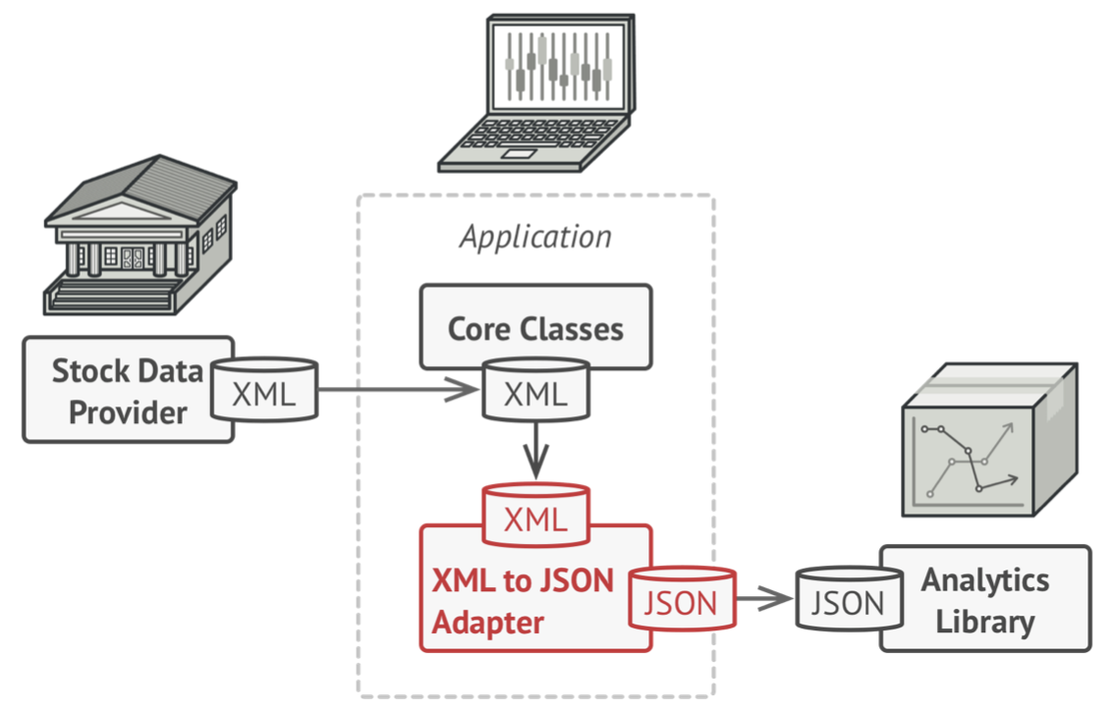
Adapter Pattern
The adapter gets an interface, compatible with one of the existing objects.
Using this interface, the existing object can safely call the adapter’s methods.
Upon receiving a call, the adapter passes the request to the second object, but in a format and order that the second object expects.

Slide 44
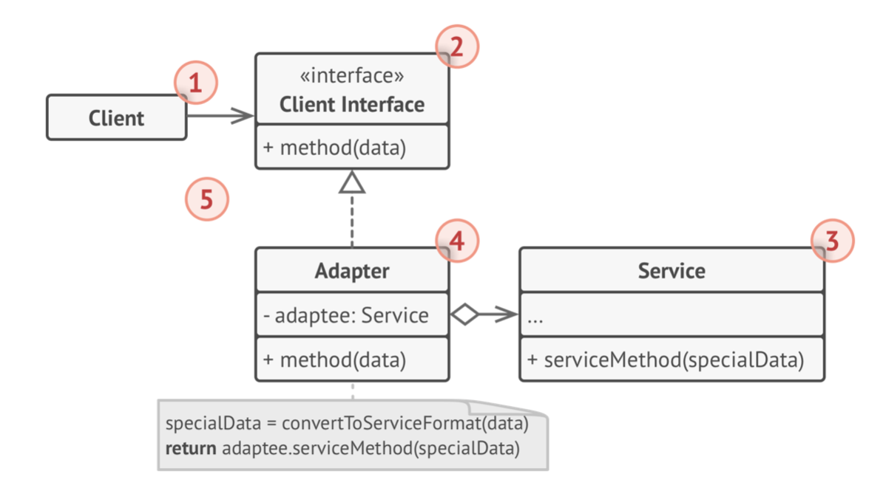
Adapter Pattern – The Structure
Also check out the sample Java code, Weapon.

Slide 45
Key Components
The Client Interface describes a protocol that other classes must follow to be able to collaborate with the client code.
The Service is some useful class (usually 3rd-party or legacy). The client can’t use this class directly because it has an incompatible interface.
The Adapter is a class that’s able to work with both the client and the service: it implements the client interface, while wrap- ping the service object. The adapter receives calls from the client via the adapter interface and translates them into calls to the wrapped service object in a format it can understand.

Slide 46
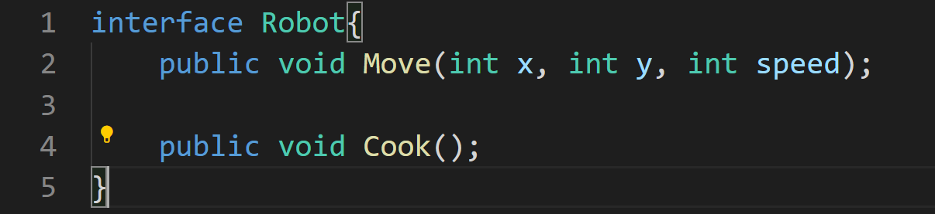
Example
Suppose we have a project of controlling robots, in which we are required to develop different kinds of robots that will be used in the PlayRobot via a common interface called Robot.

Slide 47
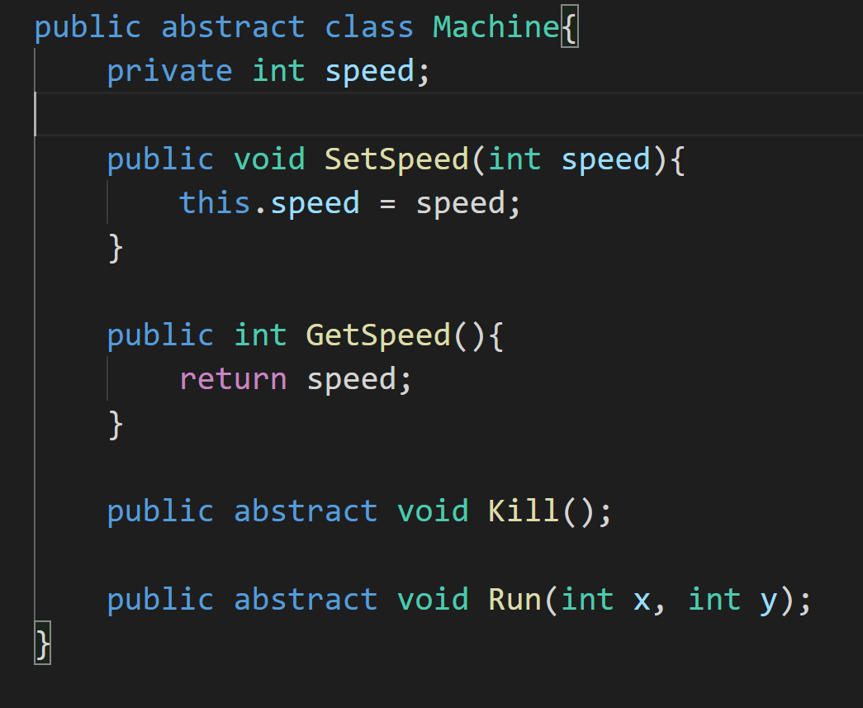
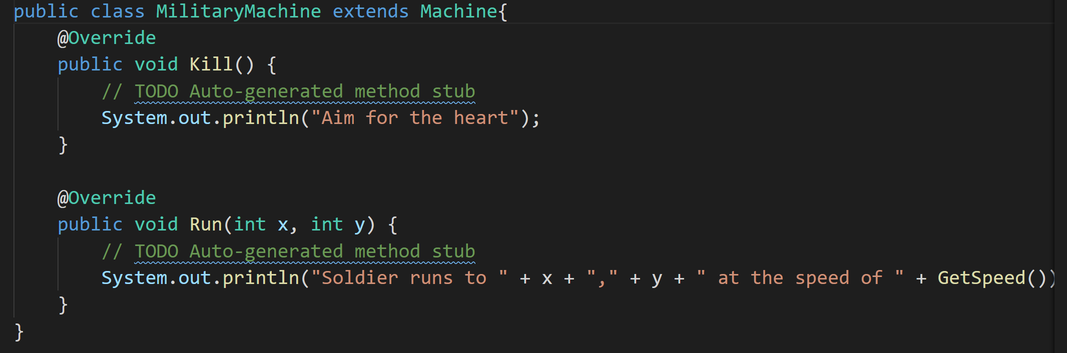
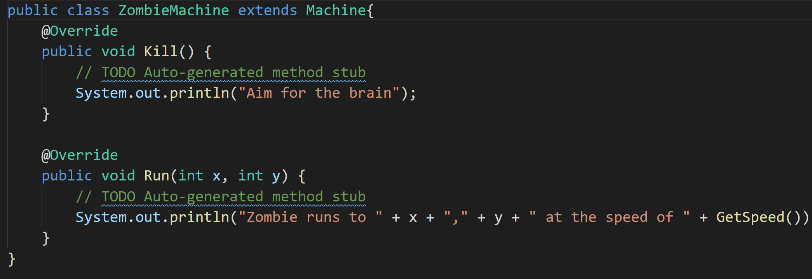
Example
As we progress, we come to know that there are some extra robots that are already developed either by some other team within our organization. Or, we have a third-party API, which is available to us.

Slide 48
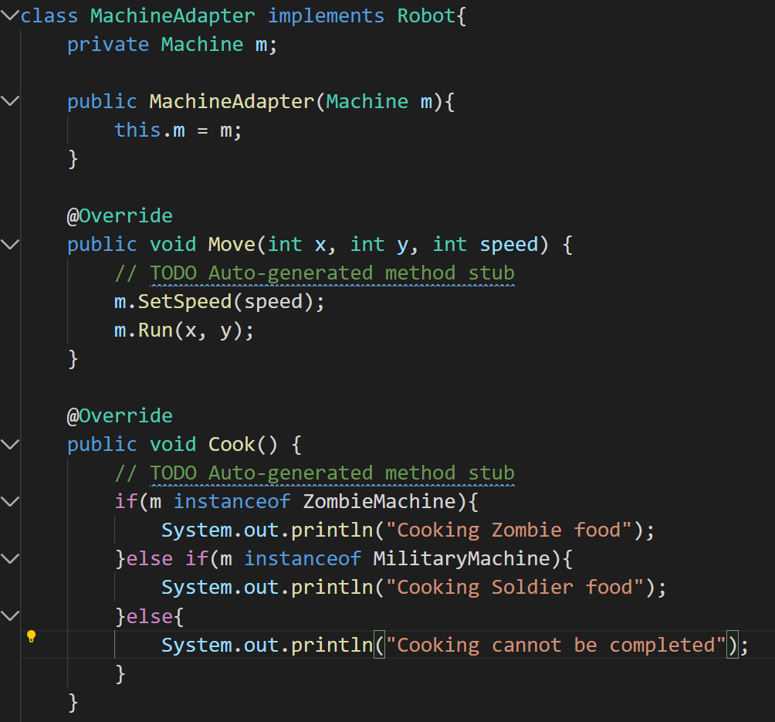
Applying adapter pattern

Slide 49
Application of Adapter Pattern
Use the Adapter class when you want to use some existing class, but its interface isn’t compatible with the rest of your code.
Use the pattern when you want to reuse several existing sub- classes that lack some common functionality that can’t be added to the superclass.

Slide 50
Exercise 5
Consider an e-commerce scenario where users can make payments using different payment systems like PayPal, CreditCards, and cryptocurrencies.
Each of these payment systems has a different API and integration process. When a user chooses a payment method, your system should process the payment using the respective payment system's API. Directly integrating these different APIs into your system can lead to a lot of complexities and code clutter.
Show and discuss your implementation.

